Slide 1

Freenet as a broker for „Medical“ IoT Data
Bachelor thesis– Bern University of Applied Science
25.06.2021
Student: Yannick Stebler
Professor: Prof. Dr. Emmanuel Benoist
Expert: Daniel Voisard

Slide 2
Index
Topic – Problem definition
Goals
Freenet (Broker)
Architecture
Attacks
Prototype
Problems
Conclusion
Questions

Slide 3
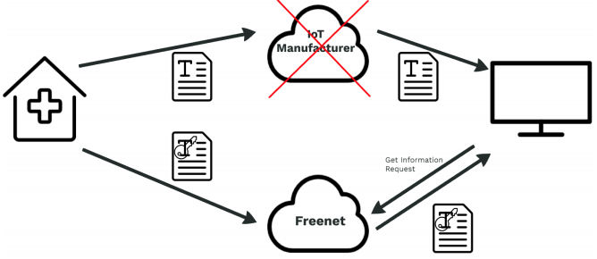
Topic - Problem definition
IoT devices are on the rise
Many make everyday tasks easier
Same problem for all of them
Data Exchange via manufacturer
Dependency to the manufacturer
In case of bankruptcy device useless
=

Slide 4
Goals
Define new communication path
Largely anonymous communication
Protect the exchange of data
Data access only for authorized parties
Document the architecture of the new communcation path
Implement it in a small prototype
IoT sending device programmed with C
Receiver programmed with C#

Slide 5

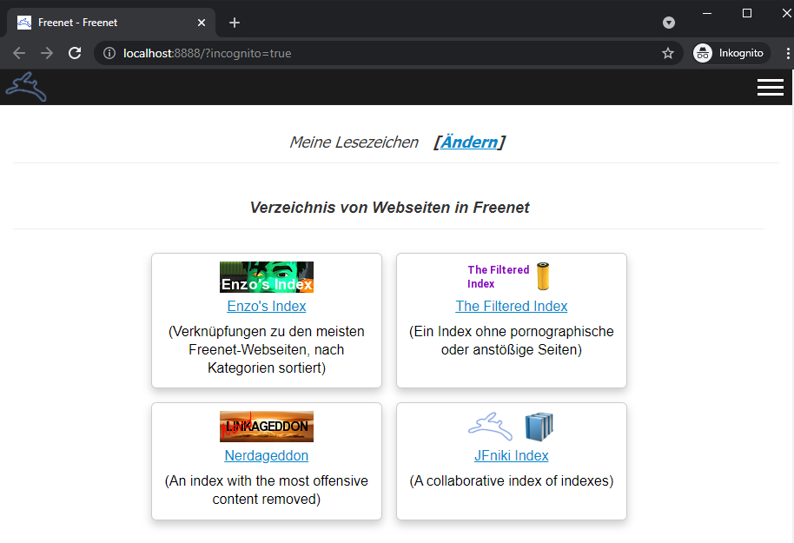
Freenet (Broker)
Free software
Peer-to-peer platform for censorship-resistant communication
Share files, browse and publish „freesites“ and chat on forums
Encrypted communication
Contribute to the network with bandwith and a portion of hard drive storage
Is used as Broker in my Thesis
More information on: https://freenetproject.org

Slide 6
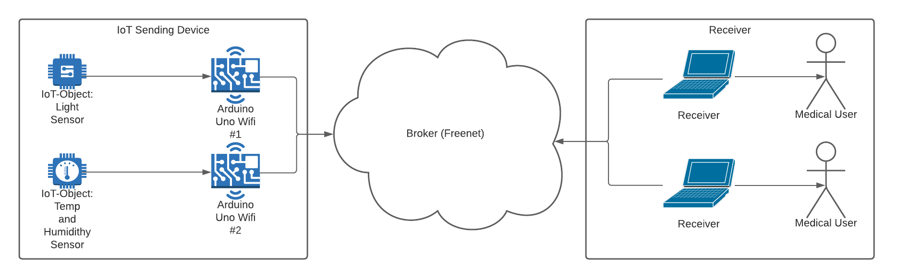
Architecture – Overview

Slide 7
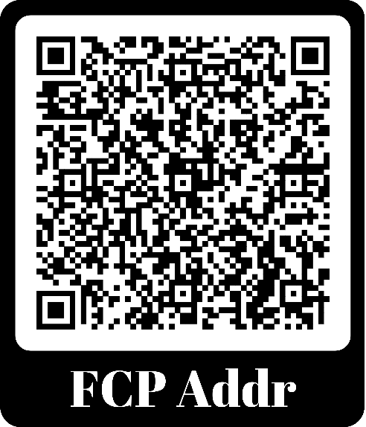
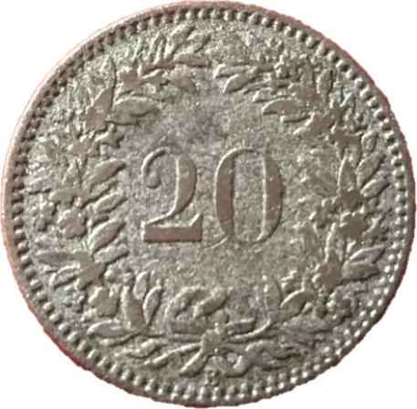
Architecture – Initialisation 1
Freenet uses his own Protocol FCP – Freenet Client Protocol
Input limitation of small IoT device
Scratchable QR-code of upload URI (Path)

Slide 8
Freenet – FCP Keys
Freenet uses Keys to address files
4 Types of Keys (CHK, SSK, USK, KSK)
Only USK allows for update of Content (File)
Usage of USK – Updateable Subspace Keys
USK@public key hash,decryption key,crypto setting/user selected name/version
USK@VuHdPK~~8ArRcYhGU7JlibgTKSrnxLRH4jR1PCiHrUU,9SFpiAvN3pBYHyY~OSkwIk7wU33WYIU3a7Rt1fdmz~8,AQECAAE/temp/1

Slide 9
Freenet – FCP Protocol
Send
ClientGet
URI=<USKURIRequest>
Identifier=<Identifier>
ReturnType=direct
PriorityClass=<Priority>
EndMessage
Receive
DataFound
Identifier=<identifier>
CompletionTime=<time>
StartupTime=<time>
DataLength=<dataLenght>
Global=false
Metadata.ContentType=text/plain
EndMessage
AllData
Identifier=ArduinoTemp2
CompletionTime=<time>
StartupTime=<time>
DataLength=<dataLenght>
Global=false
Metadata.ContentType=text/plain
Data
<DataRequested>
ClientHello: On connection first message
GenerateSSK: To generate new SSK/USK Keypair
ClientPut: To upload Data to Freenet
ClientGet: To request Data from Freenet
Send
ClientHello
Name=<Identifier>
ExpectedVersion=<Version>
EndMessage
Receive
ClientHello
Name=<Identifier>
ExpectedVersion=<Version>
EndMessage
Send
GenerateSSK
Identifier=<Identifier>
EndMessage
Receive
SSKKeypair
InsertURI=<SSKURIInsert>
RequestURI=<SSKURIRequest>
Identifier=<Identifier>
EndMessage
Send
ClientPut
URI=<USKURIInsert>
Metadata.ContentType=text/plain
PriorityClass=<Priority>
Identifier=<Identifier>
DataLength=<dataLenght>
Data
<DatatoUpload>
Receive

Slide 10
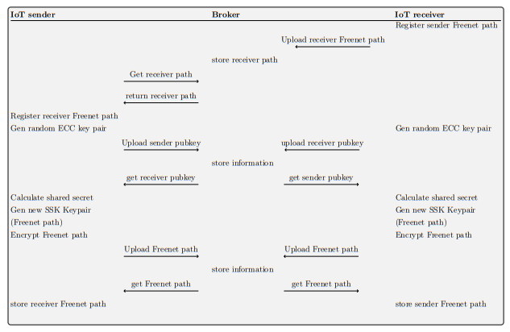
Architecture – initialization 2
ClientPut
Steps:
Scan QR-Code Sender on Receiver
Register Receiver URI on Sender
Both generate ECDH Keypair
Exchange Public Keys
Calculate Shared Secret and Generate new URIs
Exchange Encrypted URIs
ClientGet
ClientPut
ClientPut
ClientGet
ClientGet
GenerateSSK
ClientPut
ClientPut
ClientGet
ClientGet
Shared Secret Secure Channel

Slide 11
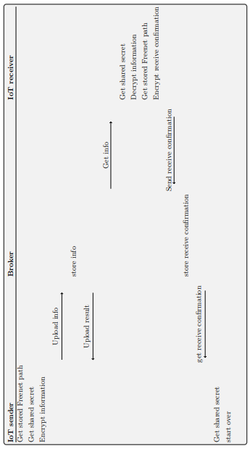
Architecture – Data transmission
Steps:
Sender get stored information
Read sensor data
Encrypt sensor data and upload
Receiver download data
Decrypt sensor data
Send receive confirmation to sender
ClientPut
ClientGet
ClientPut
ClientGet

Slide 12
Attacks and Prevention
Spoofing of the data
Interruption of the data flow by flooding Freenet
Phyiscal attack on IoT sender
Physical attack on Freenet Node Hardware

Slide 13
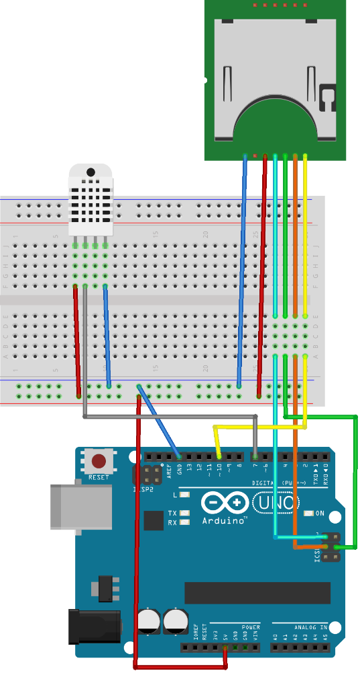
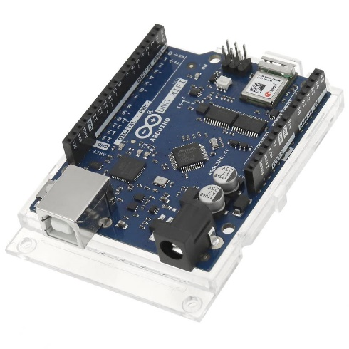
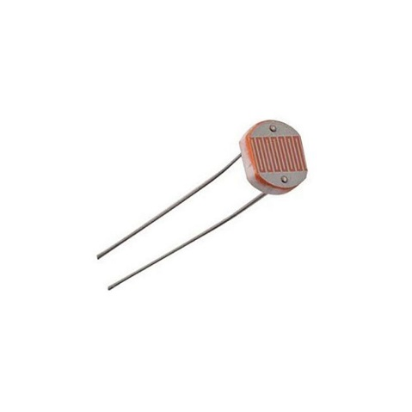
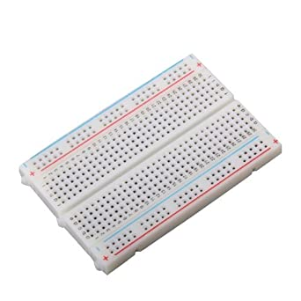
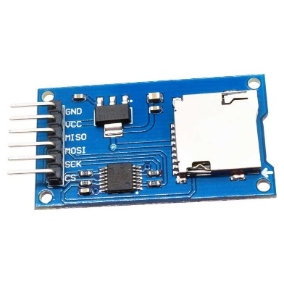
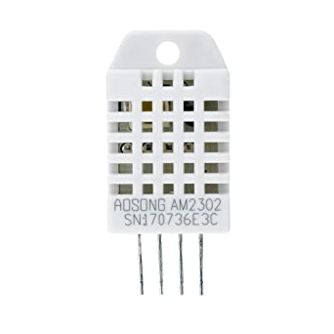
Prototype – Hardware
Hardware used:
Arduino Uno Wifi Rev.2
LDR – Light Dependent Resistor
DHT22 – Temp and Humidity sensor
Breadboard
Micro SD Card Reader Modul

Slide 14
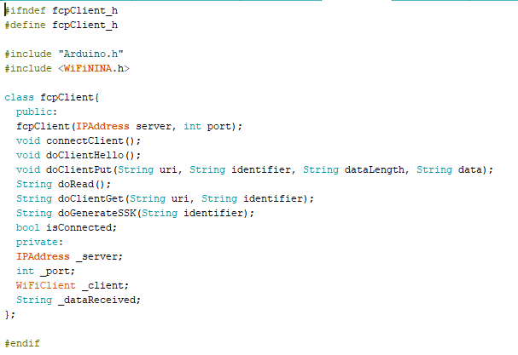
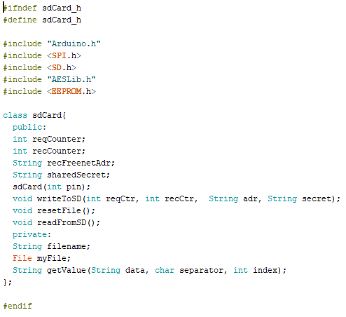
Prototype - Sender
Written in Arduino IDE with C / C++
Self written fcpClient Class
Self written sdCard Class
For each Sensor one Application
Uses micro-ecc Library for ECDH

Slide 15
Prototype – Receiver
Written in Visual Studio with C#
Currently Console Application
Uses fcp2lib.NET Library as Freenet client
Uses ECDiffieHellmanCng Class for ECDH Key generation
Uses Aes Class for Encryption and Decryption

Slide 16
Prototype - Status
Connection to Freenet working
Receiver registration working
Exchange of Public Keys for ECDH working
Generation of Shared Secret working
But Shared Secret is not identical
Not able to fix in time
Limited programm space on Arduino – uses currently 87% of Sketch Space
Great lack of documentation for the libraries (micro-ecc, fcp2lib.NET)
Sadly no demonstration possible – not fully functional Prototype

Slide 17
Conclusion
Deffined / Developed a new communication path
Anonymous and protected communication implemented
Was a very demanding work
Still a lot of room for improvement (Prototype)
Was able to put many theoretical learnings into practice

Slide 18

Questions

